Slide 1
Trace files

Slide 2
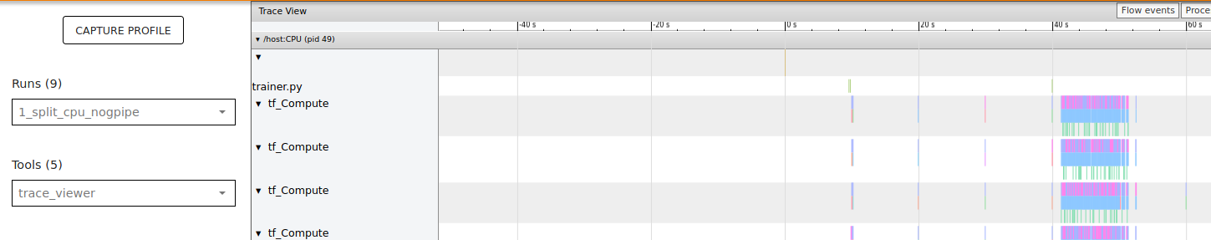
The look
The model variation
Individual threads/streams
Timeline of operations

Slide 3
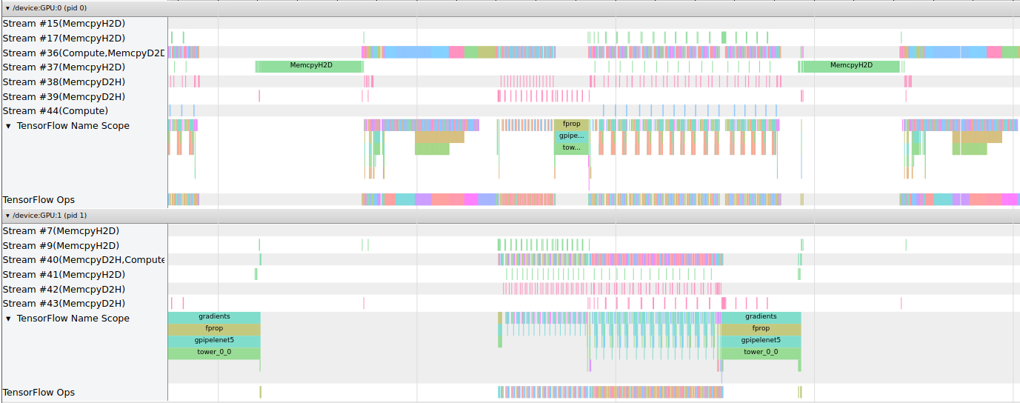
High level view of operations
Loading graph vars
Pre-processing
fprop
bprop
Device

Slide 4
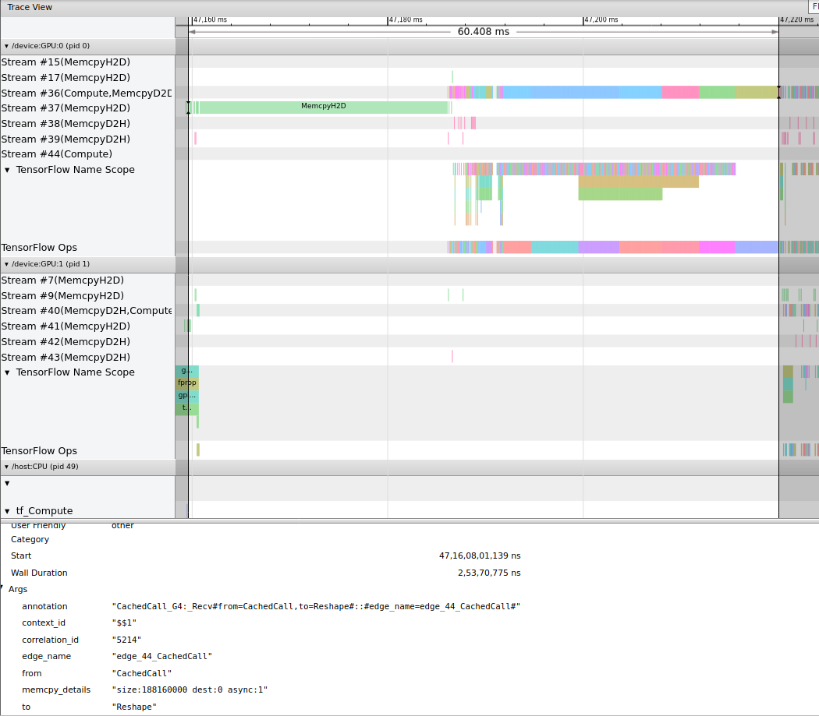
Part 1 Bulk memory transfer & pre-processing (Gpipe)

Slide 5
It is also the most expensive call among send/recv

Slide 6
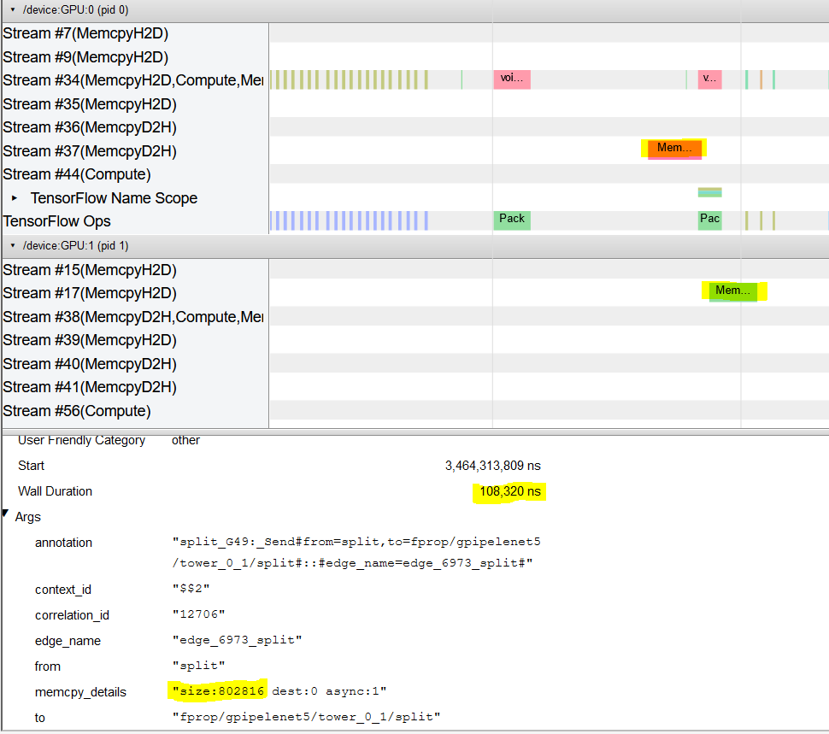
Minibatch transfer. This does not take as much time when compared to loading graph variables
For minibatch of dimensions (256,28,28,1), float32, size is 256*28*28*1 *4 = 802816

Slide 7
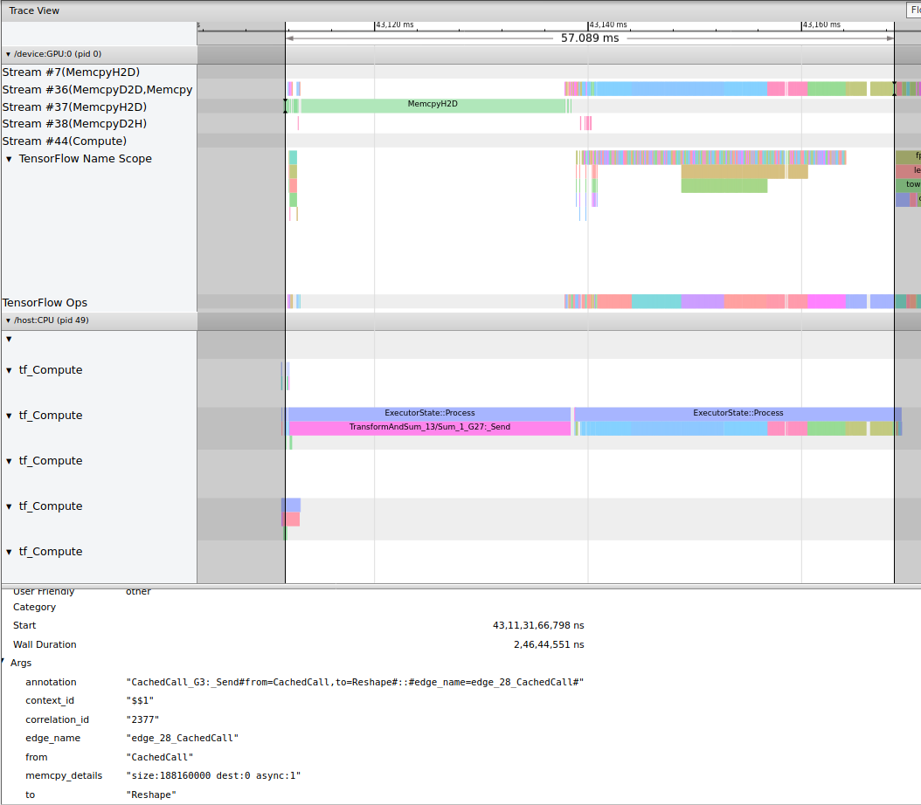
Pre-processing and mem transfer (no gpipe)
Observer that this pre-processing time is similar in both gpipe and w/o gpipe case

Slide 8
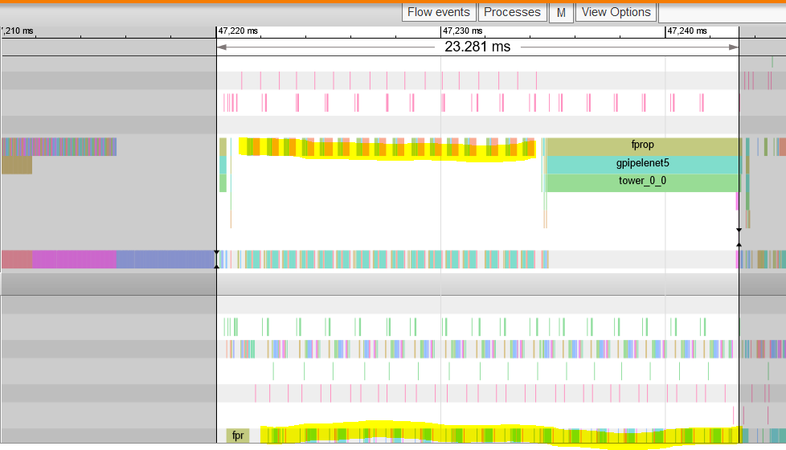
Part 2: FProp
Fprop computations on gpu 0
Fprop operations on gpu 1
Send

Slide 9
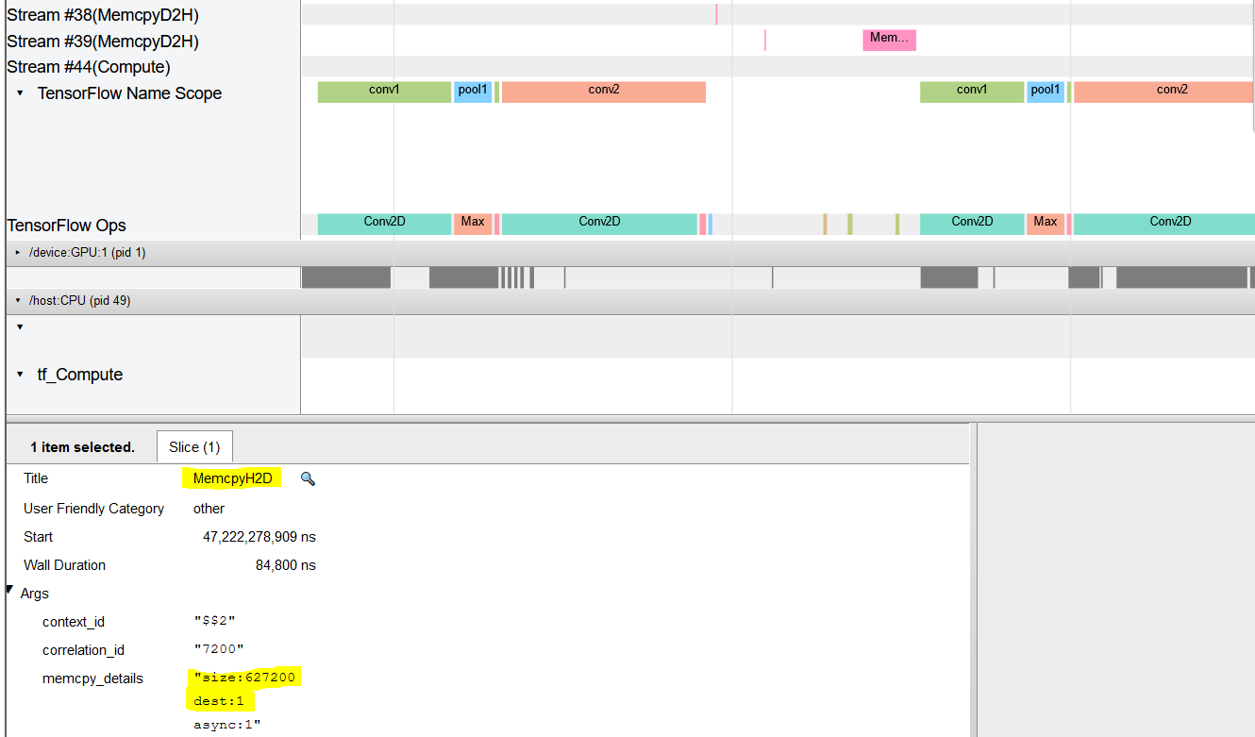
First partition’s ops only performed
Output of conv2 is (16,14,14,50), float32. 627200 bytes corresponds to this output

Slide 10
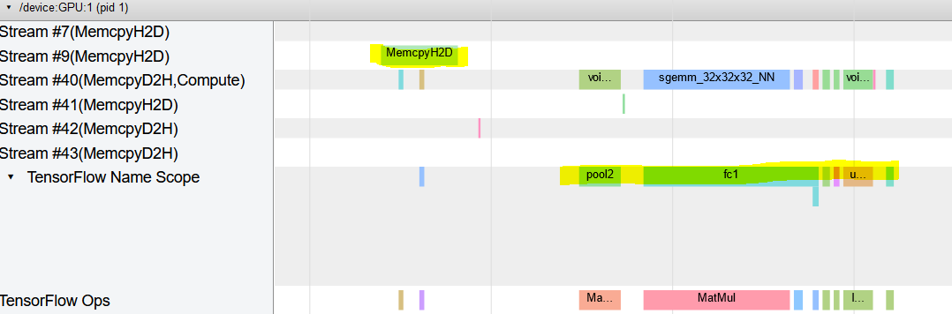
Operations on gpu 1
Corresponding recv

Slide 11
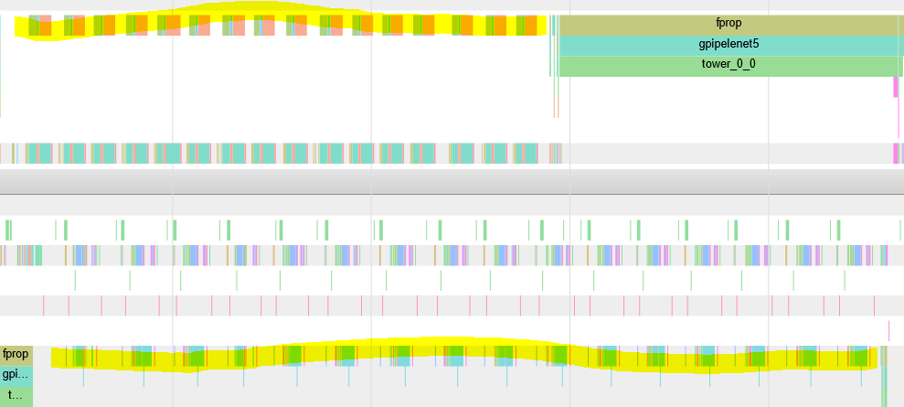
Last fprop. Done on 16th micro-batch.
The difference in processing a microbatch from one partition to the next becomes increasingly skewed. GPU:0 proceeds with next microbatch without any concern for how much is completed on GPU:1

Slide 12
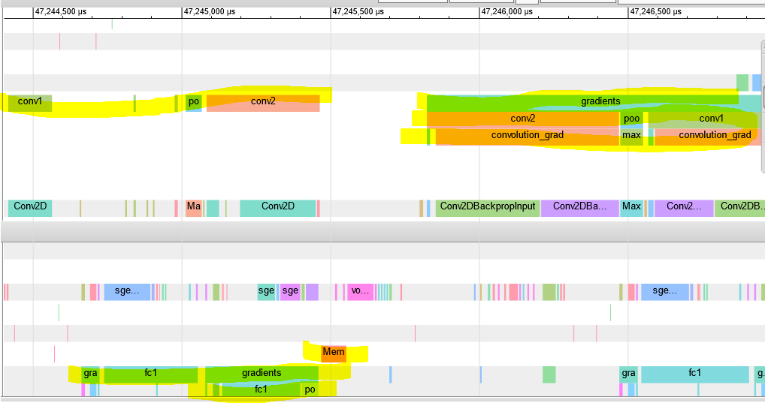
Part 3: BProp
recomputation
Backprop computation done on first split after recv called (not shown in pic)
Recomp.
D2D comm.
Bprop on gpu1

Slide 13
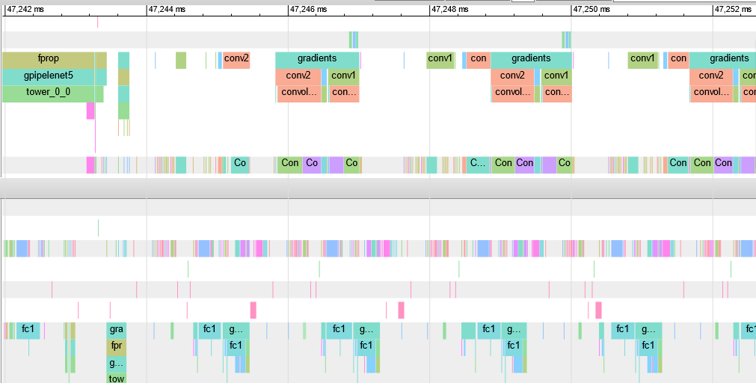
This process keeps happening…
recomputation

Slide 14
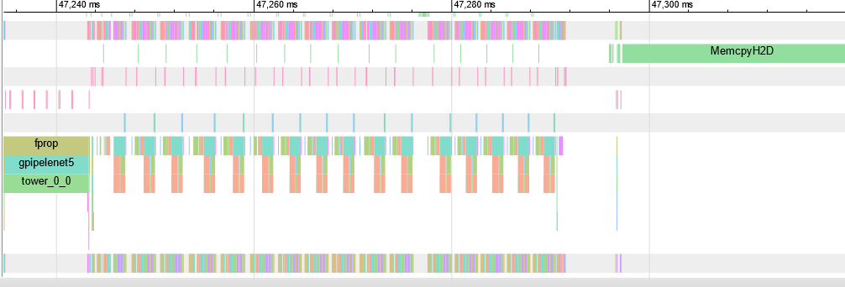
Next minibatch
Happens 16 times (Bprop)

Slide 15
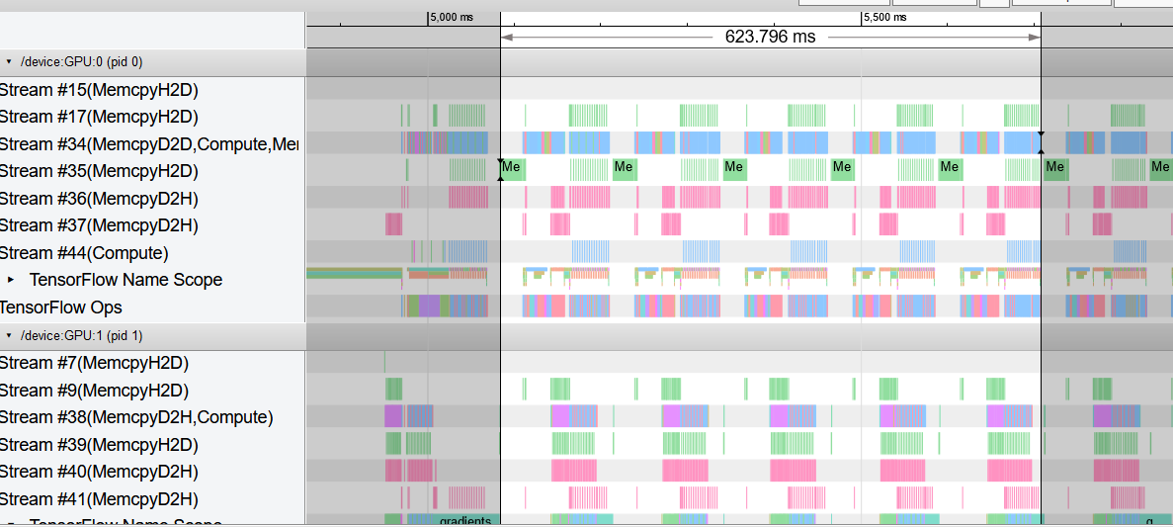
Comparisons
2 gpu 2 split gpipe
Estimated time for 5 minibatches
Avg. per minibatch ~124-125 ms

Slide 16
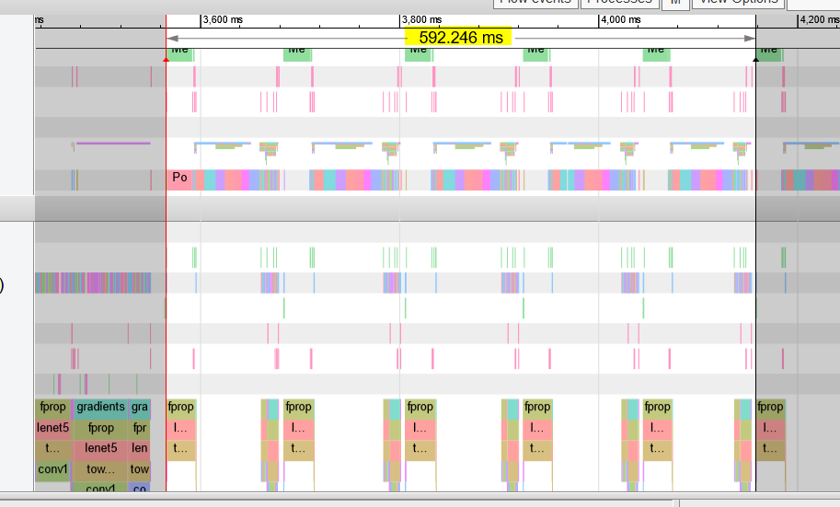
2 gpu 1 split, 1 minibatch per gpu, no gpipe (data parallel)
Avg time per minibatch = 592.246/10 = 59.2246 ms

Slide 17
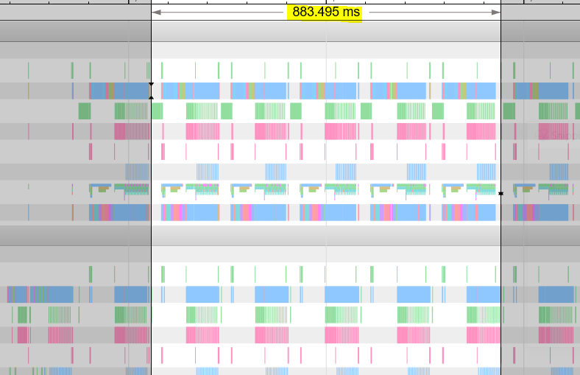
2 gpu 1 split, 1 minibatch per gpu, gpipe (data parallel)
Avg time per minibatch ~ 88.3495 ms

Slide 18
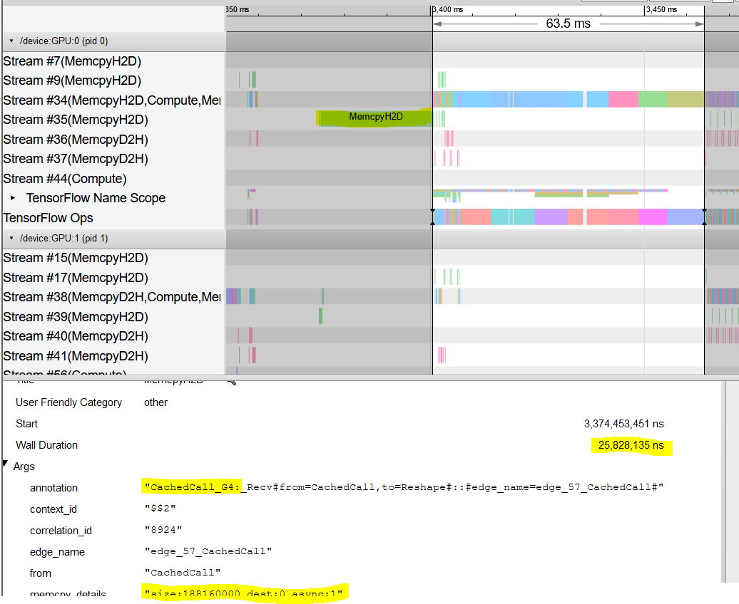
Compare this value with preprocessing time for non data parallel approach (upcoming slides)
Graph op load time

Slide 19
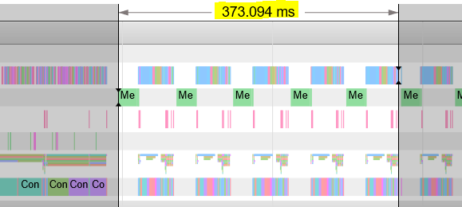
1 gpu 1 split no gpipe (Normal situation)
Avg time per minibatch ~ 74.62 ms

Slide 20
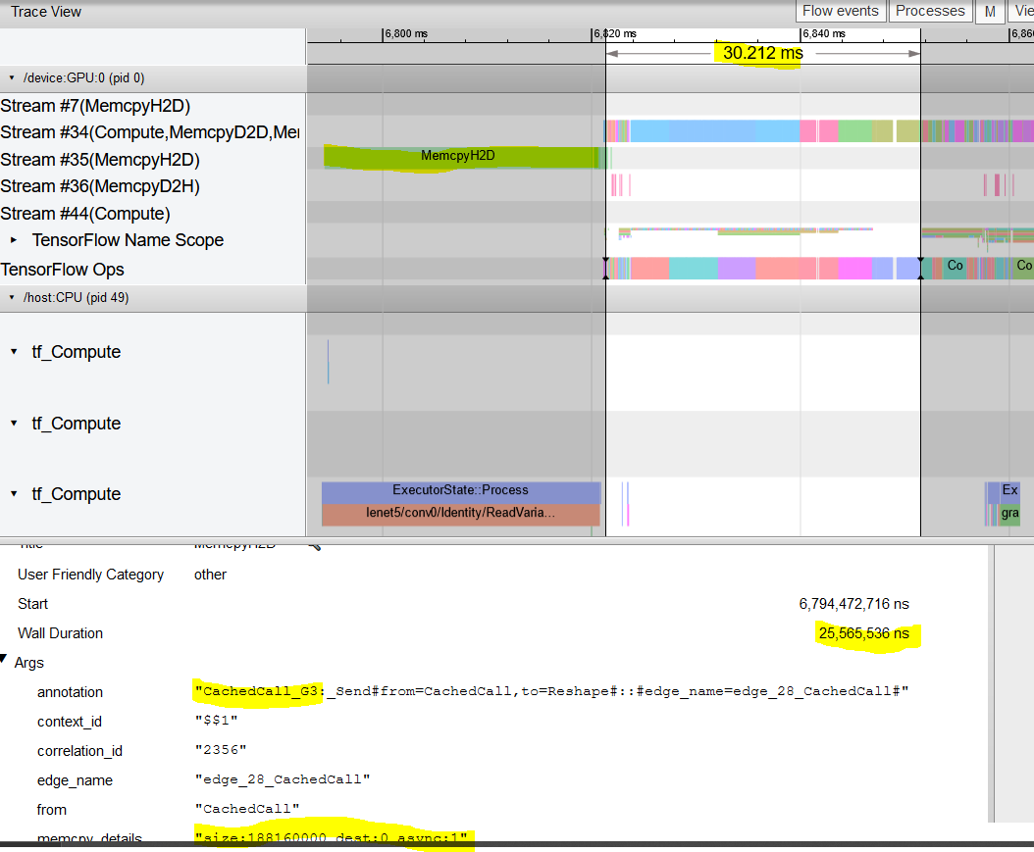
The data parallel approach takes approx. 2x time for this stage because gpu:0 processes the minibatches for both gpu:0 and gpu:1 before sending.
No signif. diff with data parallel approach in graph operation load

Slide 21
Primary consideration
To evaluate whether Gpipe gives better performance, consider the 1st and last cases from the comparisons. i.e 2 split, 2 gpu, gpipe and 1 split, 1 gpu, no gpipe (normal scenario)

Slide 22
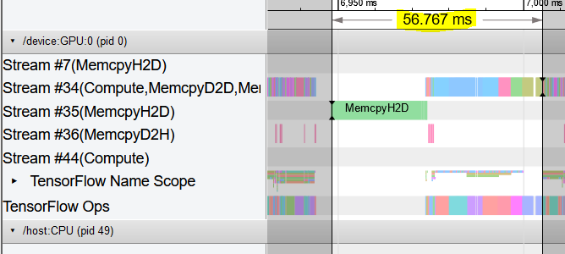
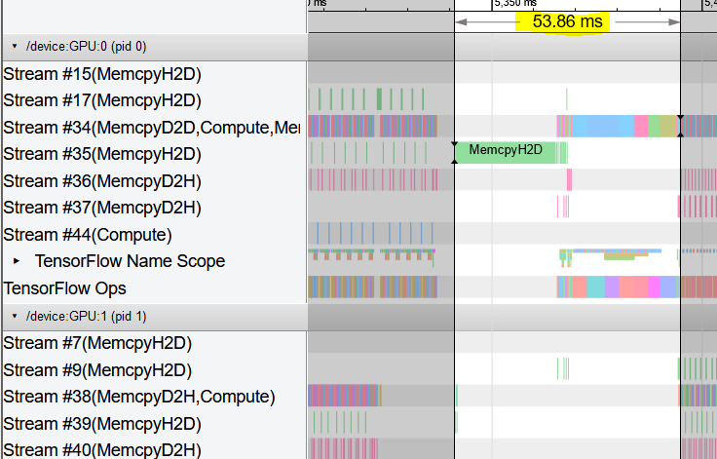
Setup times
No GPipe
GPipe
No significant diff in setup times

Slide 23
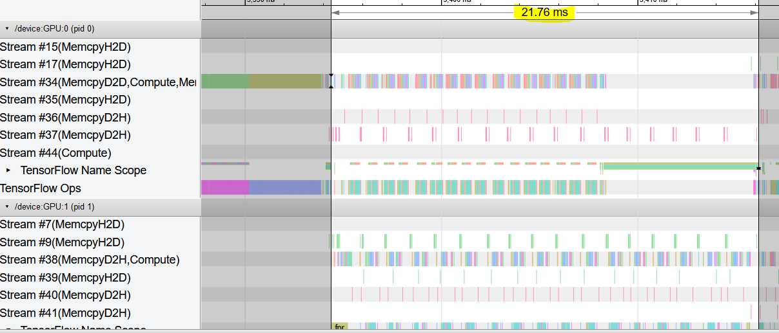
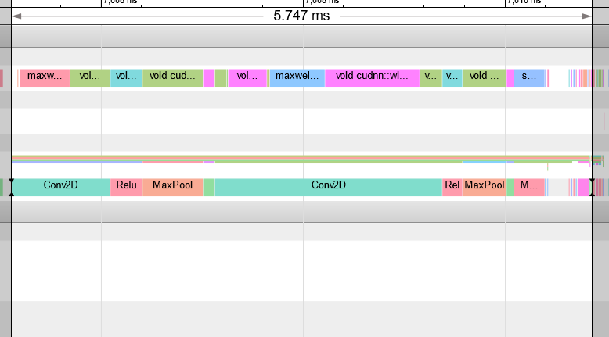
Fprop times
gpipe
No gpipe
Gpipe performs much worse than non-gpipe in this section

Slide 24
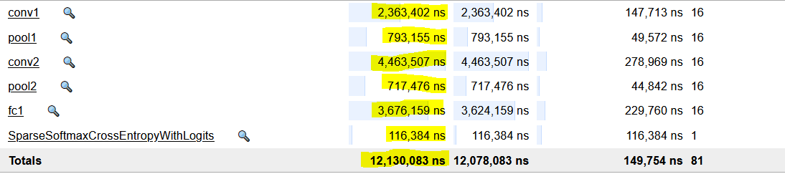
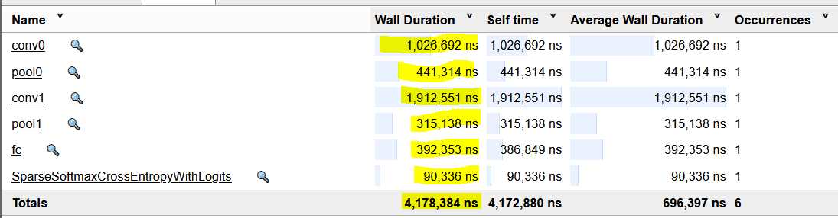
Fprop times
For most operations, cumulative micro batch time has taken approx. 2-3 times the batch processing case. For FC layer alone, Gpipe takes significantly longer.
Time spent in send/recv/stalls due to them is approx. 21.76 ms - 12.130 ms = 9.63 ms

Slide 25
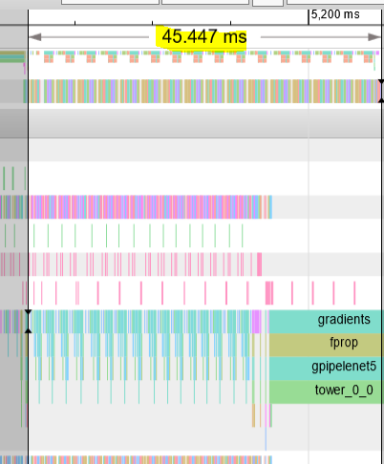
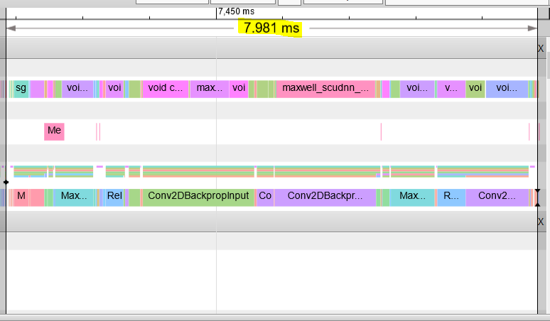
Backprop times

Slide 26
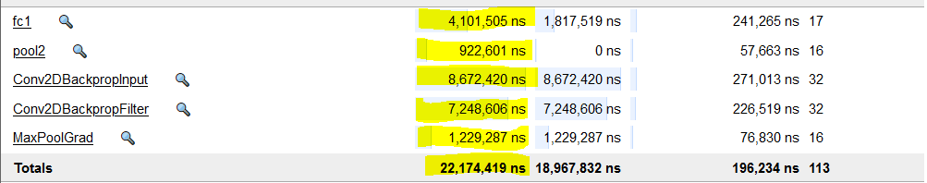
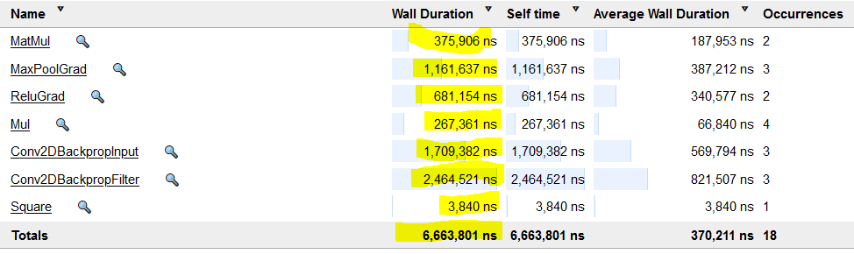
Backprop times
gpipe
No gpipe

Slide 27
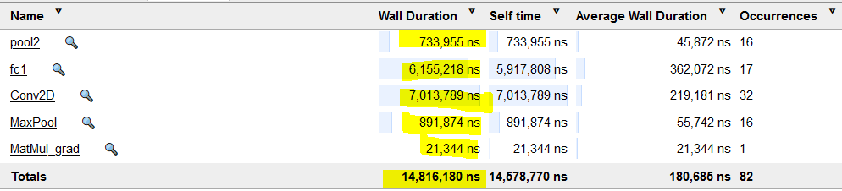
Recomputation time
Recomputation is a part of backprop. Some overlap is there with other backprop operations, but even when this overlap is ignored, the time spent in communication is atleast 45.447ms – 14.816ms – 22.174ms = 8.457 ms.

Slide 28
Remarks
Cumulative time spent in comm. does not differ by much between fprop and bprop
This is expected because data sent at boundaries is similar irrespective of fprop/bprop

Slide 29
Remarks
The primary bottlenecks seem to be:
The increase in computation times due to splitting rather than batch processing
Communication times between partition boundaries
Recomputation. Might have increasing impact with more layers

